Slide 1

Data-Center Architecture With Flow Classification P-2025-128
Students: Roi Alus, Yarin Kalfon
Supervisor: Prof. Omer Gurewitz

Slide 2

Introduction
Adnvced networking techniques like traffic classification and load balancing require a controlled testing environment.
Our project addresses that need by deploying a physical data center serving as a testbed for data plane optimization techniques.

Slide 3
Objectives
Deploy a physical data center to test and evaluate networking mechanisms.
Evaluate and Test different networking approaches such as Load Balancing, etc.
Classify real TCP flows using machine learning to support application-aware load balancing decisions.

Slide 4

The Main Challenge
Operating large-scale data centers with high-end networking and compute infrastructure requires significant financial resources.
To overcome this, we designed a small-scale, low-budget physical data center that functions as a proof of concept (PoC).
The core idea is that successful results at this scale can be extrapolated to larger deployments, requiring only additional hardware, while preserving the fundamental performance and classification behavior.

Slide 5

Project Goals
Run a Kubernetes-managed physical Data Center for controlled experimentation
Implement machine learning traffic classification using zero-length packet features
Evaluate classification accuracy and implement an application-aware load balancer driven by the classifier

Slide 6
Project Development
Deployed a physical small-scale data center to serve as a testbed for load balancing research.
Chose Kubernetes to emulate real-world data center behavior and offer a scalable, modular environment for protocol testing.
Implemented a basic prototype load balancer with simple decision rules to validate end-to-end functionality.
Identified a key assumption in many load balancing protocols (e.g., CONGA): prior knowledge of the application generating each flow.
Since our setup lacked this information, we realized the need for real-time application identification.
This led to the development of a traffic classifier capable of inferring the application based on flow characteristics.

Slide 7
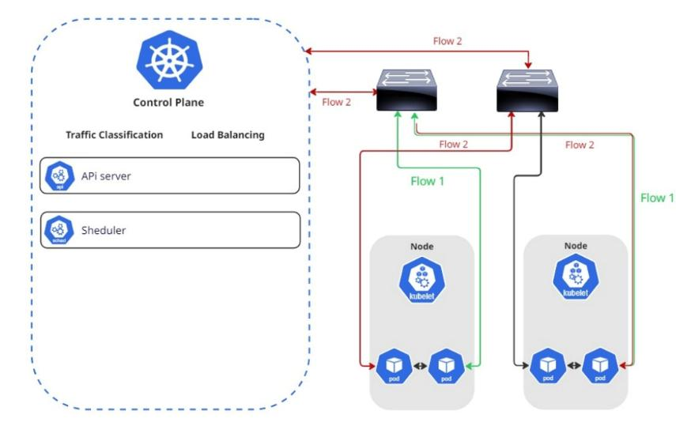
Data-Center Architecture

Slide 8
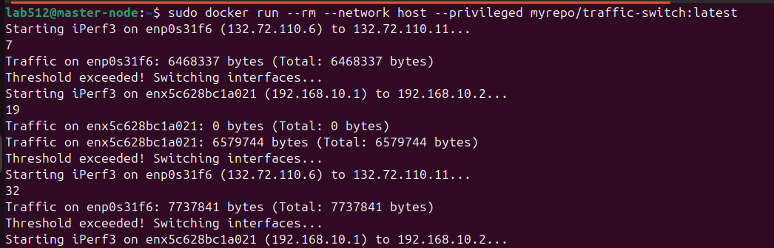

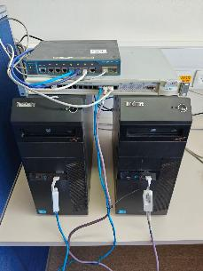
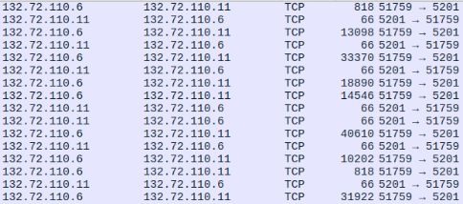
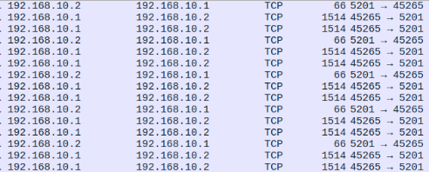
Prototype Load-Balancer Deployment
Wireshark Captures

Slide 9

Important Experiments
Experiment with several methods for designing and editing the Kubernetes default load balancer, by applying different rules for traffic distribution with applying prototype load balancer.
1
Build and Implement ML Application-Based Traffic-Classification Model Based On “Traffic Classification Based On Zero Length Packets”
2
Real-time traffic was captured directly from live flows. The classifiers accuracy was evaluated on updated TCP application data packets.
3

Slide 10


Motivation For Traffic Classifier
Most modern load balancing strategies in data centers rely on prior knowledge of application types (e.g., distinguishing between elephant and mouse flows). This assumption simplifies traffic handling but limits adaptability in dynamic or encrypted environments.
One well-known example is Hedera: Dynamic Flow Scheduling for Data Center Networks (Microsoft Research, 2010), which classifies flows by size and schedules elephant flows separately from mice to avoid congestion.
To address this, we sought to develop a traffic classifier that can infer application types in real time, enabling more intelligent and adaptive load balancing.

Slide 11
Inspired By: Traffic Classification Using Zero-Length Packets
We Used the Following Paper:
Title: Traffic Classification Based on Zero-Length Packets Authors: Joseph Kampeas, Asaf Cohen, Omer Gurewitz Published in: IEEE Transactions on Network and Service Management, Vol. 15, No. 3, September 2018
Key Contributions:
Lightweight Fingerprinting: Uses only zero-length TCP packets (e.g., ACKs) for classification, minimizing resource usage.
a-APDU Signatures: Extracts application-level data exchange patterns from TCP headers, enabling classification without payload access.
High Accuracy on Encrypted Traffic: Achieves ~97% classification accuracy using a J48 decision tree, often with just 3–4 a-APDU exchanges per flow.

Slide 12
Applying the Classifier on Real-World Data
We re-implemented the paper's zero-length packet classifier in Python using modern machine learning tools.
Trained on the original dataset, our model achieved 94% accuracy, closely matching the paper's reported results (~97%).
Testing on newer PCAPs from current applications revealed a significant accuracy drop.
Further investigation showed that protocol evolution (e.g., HTTP/3, QUIC) likely caused changes in traffic patterns.
We collected fresh traffic, retrained the model, and restored performance to 94%, demonstrating the classifier’s continued relevance in modern networks.

Slide 13
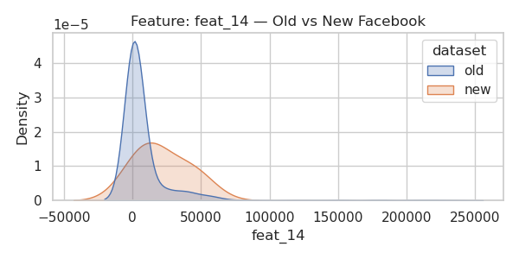
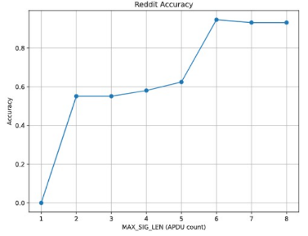
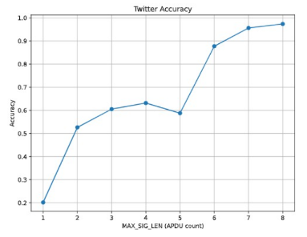
Classifier - Results & Findings
Initial training on legacy data yielded high accuracy, but performance declined under modern traffic patterns.
Protocol evolution altered flow behaviors, especially in payload exchange sequences.
After retraining on updated traffic, the classifier regained high accuracy, validating its adaptability.
Successfully deployed in real-time to support dynamic, application-aware load balancing.
Confirms that zero-length packet features remain effective even in evolving protocol environments.

Slide 14
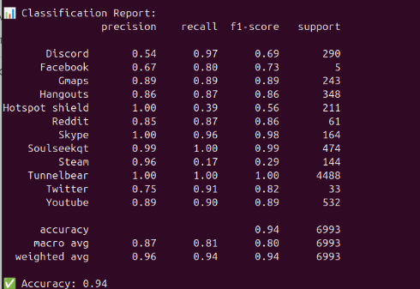
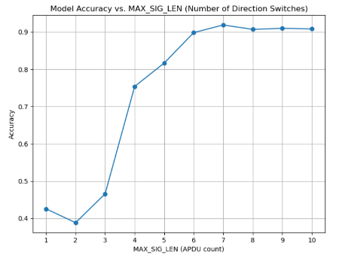
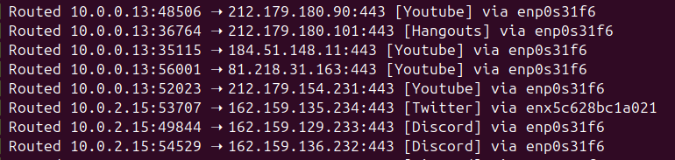
ML Based Traffic Classification
Classification Report
Accuracy Optimization
Real-Time Decisions

Slide 15
Difficulties And Problems
Load-Balancer:
There is barely any documentation available online for implementing a Kubernetes load balancer with complex decision-making rules
We decided to implement traffic classifier that will help our prototype load balancer make decisions.
Zero-Length Traffic-Classifier:
The training database was outdated. We discovered it during real-time classification testing. We saw that current traffic flows differed from the older dataset
We decided to collect new traffic data, then to re-evaluate whether the original theory still holds, and test if the module can function as a real-time classifier
Classification output is used by the load-balancer to decide how to route traffic. We couldn’t deploy Docker containers for controlled TCP flow generation in the university environment, due to security concerns
We used DNS IPs of a specific app and captured traffic using tcpdump to collect the required data

Slide 16

Conclusions & Progress Comparison
The project primary goal is deploying a physical data center testbed to explore network management mechanisms, starting with load balancing. Challenges in modifying Kubernetes' default load balancer without external tools led us to first focus on AI-based traffic classification to help us identify the type of the flows, laying the groundwork for future load balancing.

